Slide 1

[NAACL 2021] Multimodal End-to-End Sparse Model for Emotion Recognition
Wenliang Dai, Samuel Cahyawijaya, Zihan Liu, Pascale Fung
2021. 11. 22 Eung yeop Kim
Dept of AI

Slide 2
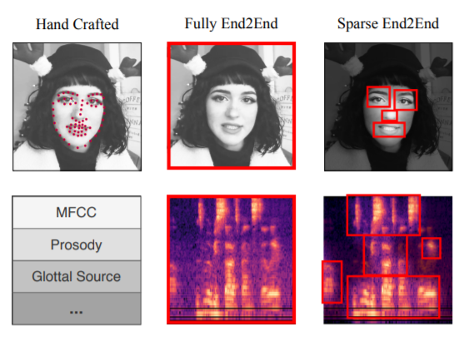
1. Abstract & Introduction
The main challenges in these tasks
Three modalities :
Textual
Acoustic
Visual
How to model the interactions between
different modalities?
<- Feature extractions resulted from each models

Slide 3
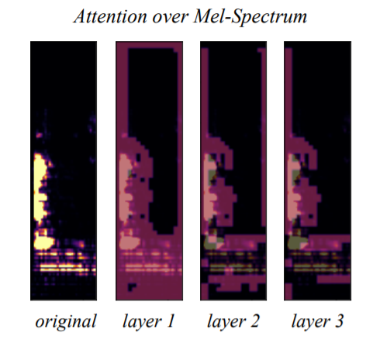
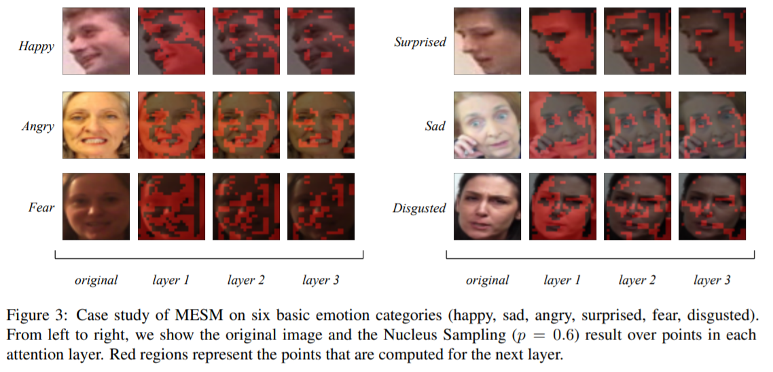
1. Abstract & Introduction

Slide 4
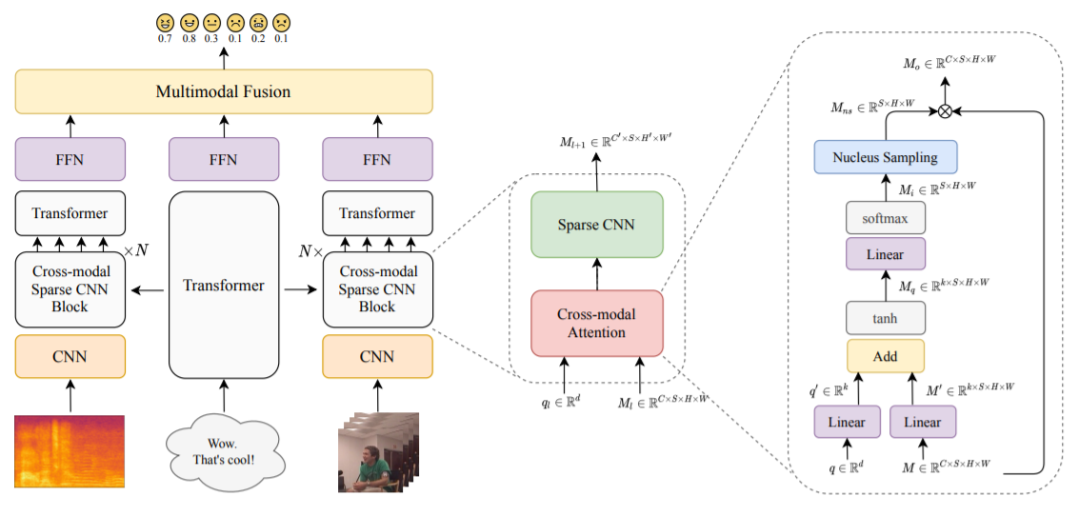
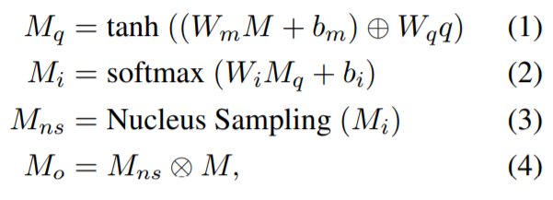




2. Methodology
I multimodal data samples :

Slide 5


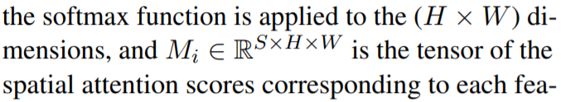



2. Methodology

Slide 6
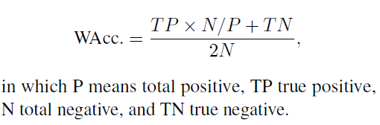
3. Experiments
0. Evaluation Metrics
1) Evaluation Metrics
- IEMOCAP dataset :
Accuracy, F1-score
- CMU-MOSEI dataset :
Weighted Accuracy, F1-score
2) Weighted Accuracy (WAcc) for evaluating the CMU-MOSEI
- It contains many more negative samples than positive ones on each emotion category.
- If normal accuracy is used, a model will still get a fine score when predicting all samples to be neg-.

Slide 7
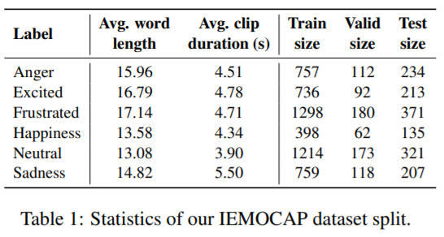
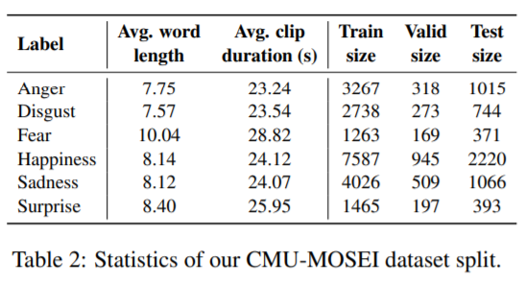
3. Experiments
1. Feature extraction step
Visual data : 35 facial action units using the Open Face library for the image frames in the video,
which capture the movement of facial muscles.
Acoustic data : a total of 142 dimension features consisting of 12 dimension bark band energy(BBE) features,
22 dimension mel-frequency cepstral coefficient(MFCC) features, and 108 statistical features
from 18 phonological classes. We extract the features per 400 ms time frame using the DisVoice library.
Textual data : the pre-trained GloVe word embeddings.(glove.840B.300d)

Slide 8
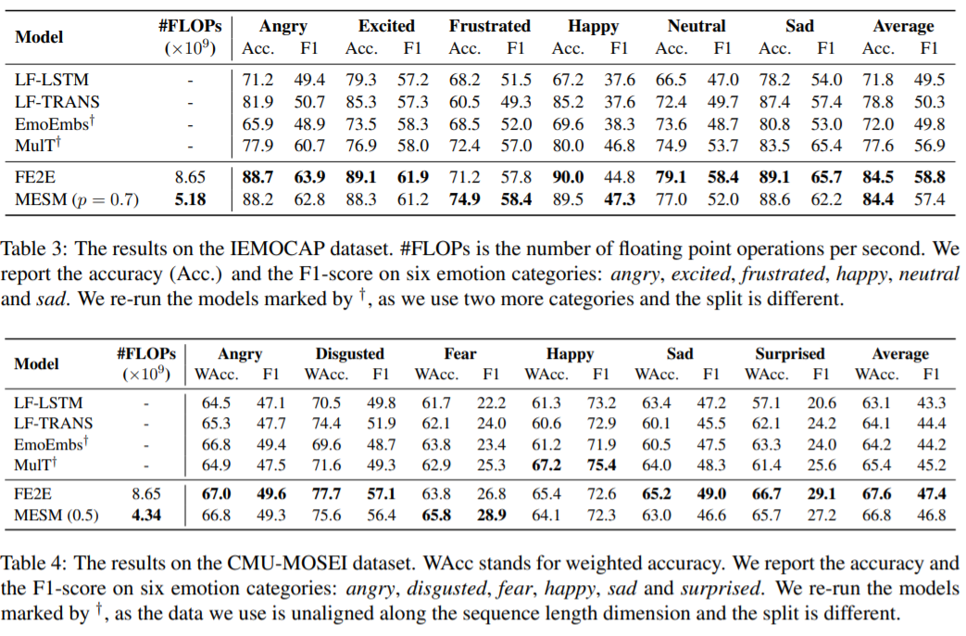
3. Experiments

Slide 9
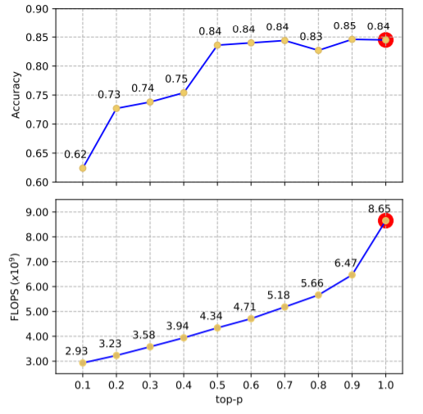
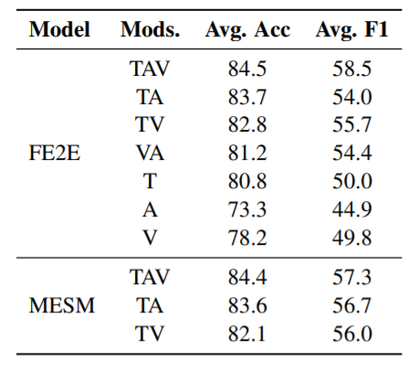

3. Experiments & Ablation Study
Effects of Nucleus Sampling
T : Textual
A : Acoustic
V : Visual

Slide 10
3. Experiments

Slide 11
4. Conclusion & Future Work
1) MESM is able to reduce the computational overhead.
2) FE2E model has an advantage in feature learning
And surpasses the current state of the-art models
3) Visualization of the cross-modal attention maps
can give an insight to determine modalities.

